Slide 1
Model View Controller Architecture

Slide 2
Model View Controller (MVC)
It is a design pattern that separates the business logic, presentation logic and the data
Controller
Acts an interface between view and model
Intercepts all incoming requests
Model
Represents the state of application
View
Represents the presentation

Slide 3
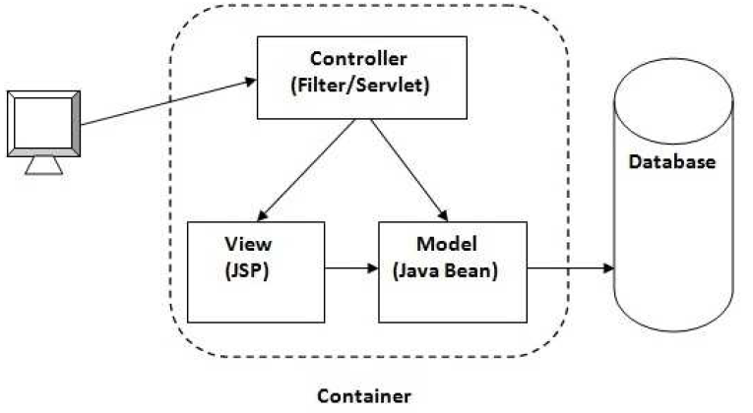
Model View Controller

Slide 4
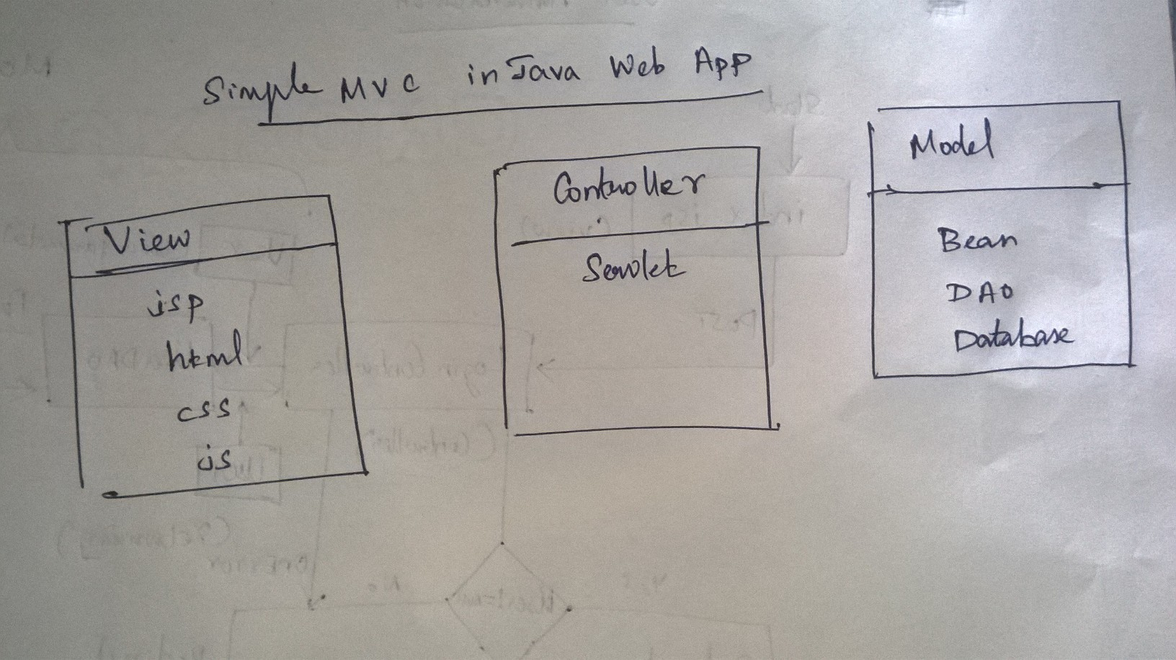
Model View Controller

Slide 5
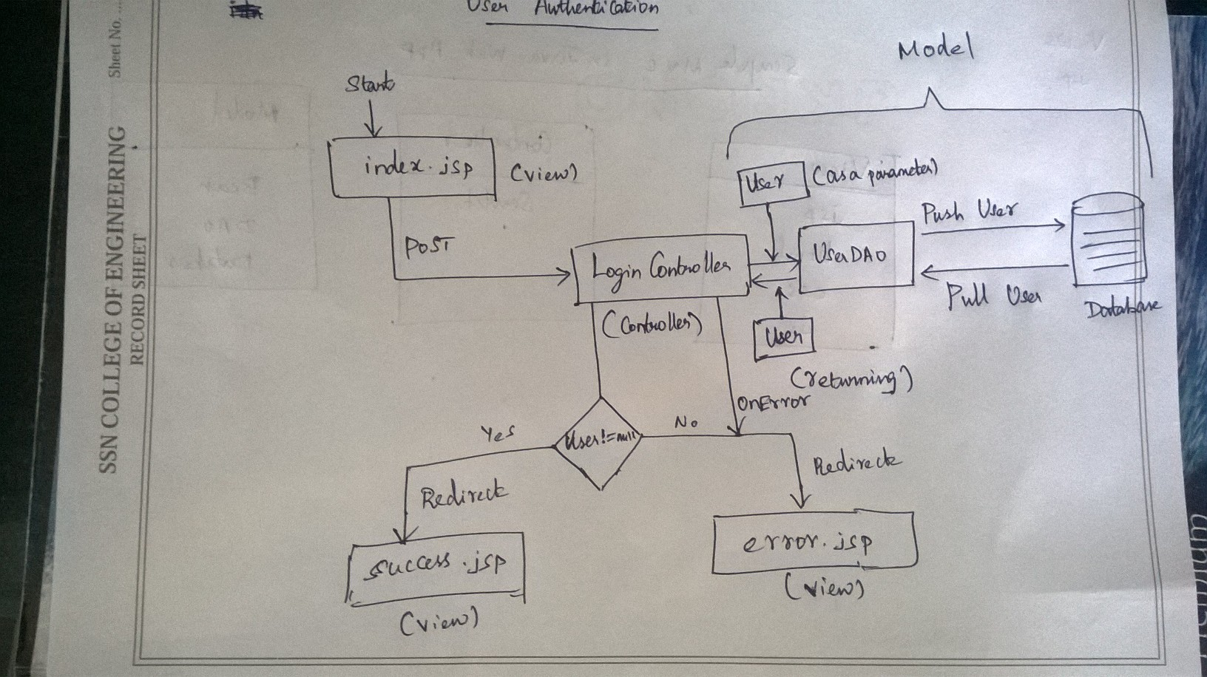
Model View Controller

